Slide 1

Introduction to Machine Learning
Course Leader: ​
Simon Kirby​
​
Course Helpers: ​
Finley Gibson​
Sam Fletcher​
Coding for Reproducible Research​
Sign in here ​
March 2025
Collaborative doc: https://tinyurl.com/fd3cd22b​

Slide 2
Code of Conduct​
Our ethos is to provide a welcoming and supportive environment for all people, regardless of background or identity. By registering to attend this workshop, participants are agreeing to abide by the Researcher Development Code of Conduct.​
Our goal is to support you to develop your programming skill sets to enable you to do cutting edge research. We want to create a positive and professional learning environment and therefore encourage the following kinds of behaviours:​
Show courtesy and respect towards all who attend a workshop or engage in community events.​
Be respectful of different viewpoints and experiences.​
Gracefully accept constructive criticism.​
Be patient if there are technical glitches. While we know something about how to use computers, we are not immune to internet or hardware issues.​
Respect our policy on not recording workshops to protect the nature of the sessions and ensure we are GDPR compliant.

Slide 3
Programme Funding​
The CfRR training programme is supported by:​
Research Software Analytics Group​
Institute for Data Science and Artificial Intelligence (IDSAI)​
University of Exeter Reproducibility Leadership Team​
EPSRC Research Software Engineering Fellowship​
Community of academics who volunteer their time to support delivery ​
To make the case for continued investment, please help us demonstrate the impact of these sessions by attending all courses you register for and providing feedback at the end of the course.

Slide 4
Intro to Machine Learning
Part 1 - What is
machine learning?

Slide 5
Course contents
Session 1
Slides: what is machine learning?
Tutorial: linear regression
Slides: model selection and evaluation
Session 2
Tutorial: model selection and evaluation
Slides: the machine learning pipeline
Tutorial: machine learning pipeline task
Session 3
Continue with machine learning pipeline task
Tutorial: unsupervised learning

Slide 6
What is machine learning?
Discuss with your neighbour!

Slide 7
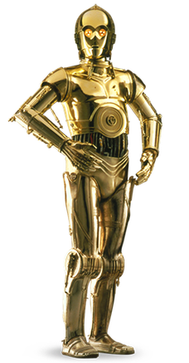


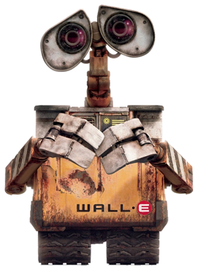
What is machine learning?

Slide 8
What is machine learning?
“Machine learning is the field of study that gives computers the ability to learn without being explicitly programmed.” - Arthur Samuel, 1959
“A computer program is said to learn from experience E with respect to some task T and some performance measure P, if the performance on T, as measured by P, improves with experience E.” - Tom Mitchell, 1997
The science (and art) of programming computers so they learn from data.

Slide 9
What is machine learning?
Traditional problem solving approach:
Launch!
Study the problem
Write rules
Evaluate
Analyse errors
Diagrams adapted from Hands On Machine Learning with scikit-learn, Keras and Tensorflow by Aurelien Geron

Slide 10
What is machine learning?
Traditional problem solving approach:
Launch!
Study the problem
Write rules
Evaluate
Analyse errors
Diagrams adapted from Hands On Machine Learning with scikit-learn, Keras and Tensorflow by Aurelien Geron

Slide 11
What is machine learning?
Machine learning approach:
Data
Launch!
We call this process of learning from data “training”
Study the problem
Train ML algorithm
Evaluate
Analyse errors
Diagrams adapted from Hands On Machine Learning with scikit-learn, Keras and Tensorflow by Aurelien Geron

Slide 12
What is machine learning?
Automatically adapting to change:
Update data
Launch!
Data
This cycle can be automated
Train ML algorithm
Evaluate
Diagrams adapted from Hands On Machine Learning with scikit-learn, Keras and Tensorflow by Aurelien Geron

Slide 13
What is machine learning?
ML can help humans learn, especially in research:
Study the problem
Train ML algorithm
Solution!
Inspect solution
Lots of data
Iterate if needed
Understand problem better
Have idea!
Diagrams adapted from Hands On Machine Learning with scikit-learn, Keras and Tensorflow by Aurelien Geron

Slide 14
What is machine learning good for?
Problems that require a lot of fine tuning, or long lists of rules. ML-based approaches can simplify the process.
Complex problems where traditional approaches do not yield a solution. Maybe ML can find a solution.
Fluctuating environments: where approaches need to adapt to new data.
Getting insights about complex problems and large amounts of data

Slide 15
Example applications
Discuss with your neighbour!

Slide 16
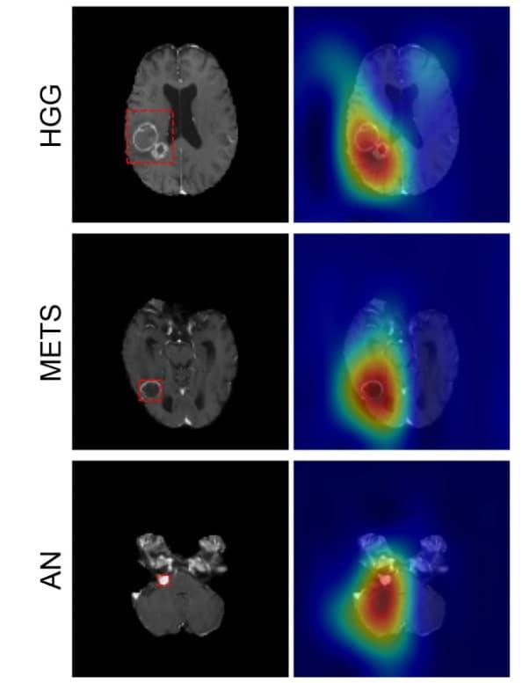
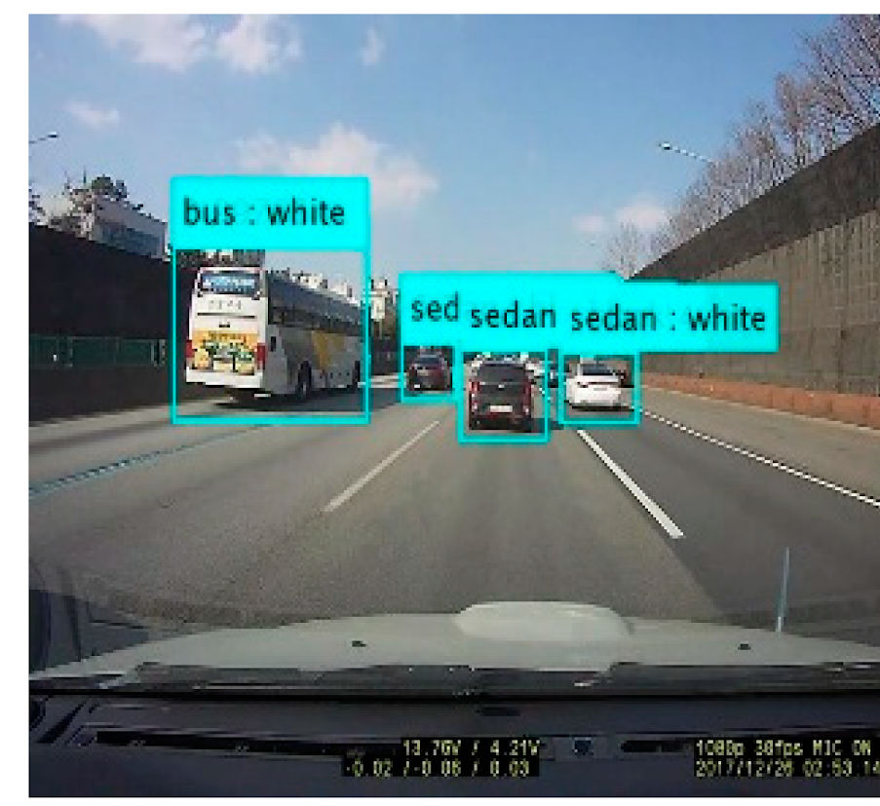
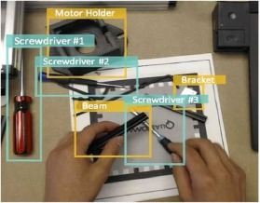
Example applications
Identifying brain tumours, classifying auto traffic, AR/VR object detection

Slide 17

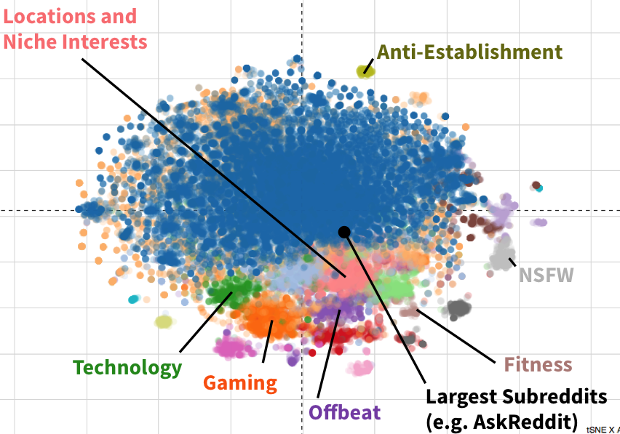

Example applications
Identifying fraudulent payments, forecasting sales growth, identifying groups of social media users

Slide 18
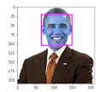


Example applications
Face recognition, building a bot for a game, building a chatbot.
And many, many more!

Slide 19
Types of machine learning task
All of these examples are solved using different machine learning algorithms.
We can classify both the type of machine learning task, and the genre of algorithm used to approach the problem.
Problem type: classification vs regression
Approach type: supervised vs unsupervised vs reinforcement learning

Slide 20
Types of machine learning task - classification
Classification: given a new sample, classify it into a predefined group
Output: a predicted label name from a predefined group
Examples:
Is this new email spam, or not spam?
Is the next pixel in a scan cancerous or not cancerous?
What object is in front of me on the road?
Did person X survive the Titanic disaster?
Will a customer on my website purchase the item they are looking at?

Slide 21
Types of machine learning task - regression
Regression: given a new sample, predict a continuous numerical value from the samples input features.
Output: a continuous numerical value
Examples:
What is the predicted fuel efficiency of a particular model of car?
What is the predicted sale value of a house, given its rooms, size & location?
How old is the person in a recording, given their facial/vocal features and behaviour?
How much money will a film earn, given its release date, genre, cast, etc?

Slide 22
Types of machine learning systems/algorithms
We can categorise ML approaches based on the amount of supervision they require when learning from data:
Supervised learning - requires the data and the solutions (labels)
Unsupervised learning - requires the data, but no solutions (labels) provided
Reinforcement learning - observe system, update policy based on reward

Slide 23
Supervised learning
Supervised learning algorithms train using input data that has been labelled.
A model is trained and its performance evaluated.
This model can make predictions on a new sample (that is unlabelled.
The model has learnt to generalise from the set of examples.
Example algorithms:
Linear/logistic regression, SVMs, random forests, etc
Neural networks

Slide 24









Supervised learning - binary image classification
Predict whether a picture of an unknown fruit is an apple or an orange.
Labelled data
Train ML model
Trained model
Predict label
Output prediction
predicted label:
“apple” or “orange”
apple
orange
apple
image
orange
orange
apple
label
New picture of unknown fruit (no label)
orange
orange
apple

Slide 25
Supervised learning - linear regression
Predict a weight based on height
Labelled data
Train ML model
Trained model
Predict label
Output prediction
Predicted numerical value (a weight in kg)
person 1 - weight: 50 kg, height: 1.5 m
person 2 - weight: 63 kg, height: 1.8 m
person 3 - weight: 41 kg, height: 1.2 m
person 4 - weight: 94 kg, height: 1.9 m
person 5 - weight: 71 kg, height: 1.8 m
person 6 - weight: 65 kg, height: 1.6 m
person 7 - weight: 54 kg, height: 1.7 m
…
A new sample:
a height in metres

Slide 26
Unsupervised learning
Unsupervised learning algorithms train using data that is not labelled.
They are often used to identify groups in data without human intervention. However, this is not a magic bullet! Results can be variable.
This task is commonly called clustering.
Example algorithms:
K-means
Principal component analysis (PCA), used for dimensionality reduction

Slide 27
Unsupervised learning - K-means clustering
Predict k cluster labels (identify groups) in a given dataset
Unlabelled data
Train ML model
Trained model
Output cluster labels
After K-means: data coloured by cluster label
With K = 2
Unlabelled data: before K-means

Slide 28
Reinforcement learning (RL)
RL algorithms (or agents) are trained to make decisions to achieve a goal with optimal results. Actions that move the agent towards their goal are reinforced, and those that move the agent away are ignored/penalised.
This is a reward/punishment approach to improve the agents policy, that can often find solutions humans cannot anticipate.
RL is often used in complex tasks, famously in AlphaGo.
Example algorithms:
Q-learning, policy gradient methods

Slide 29
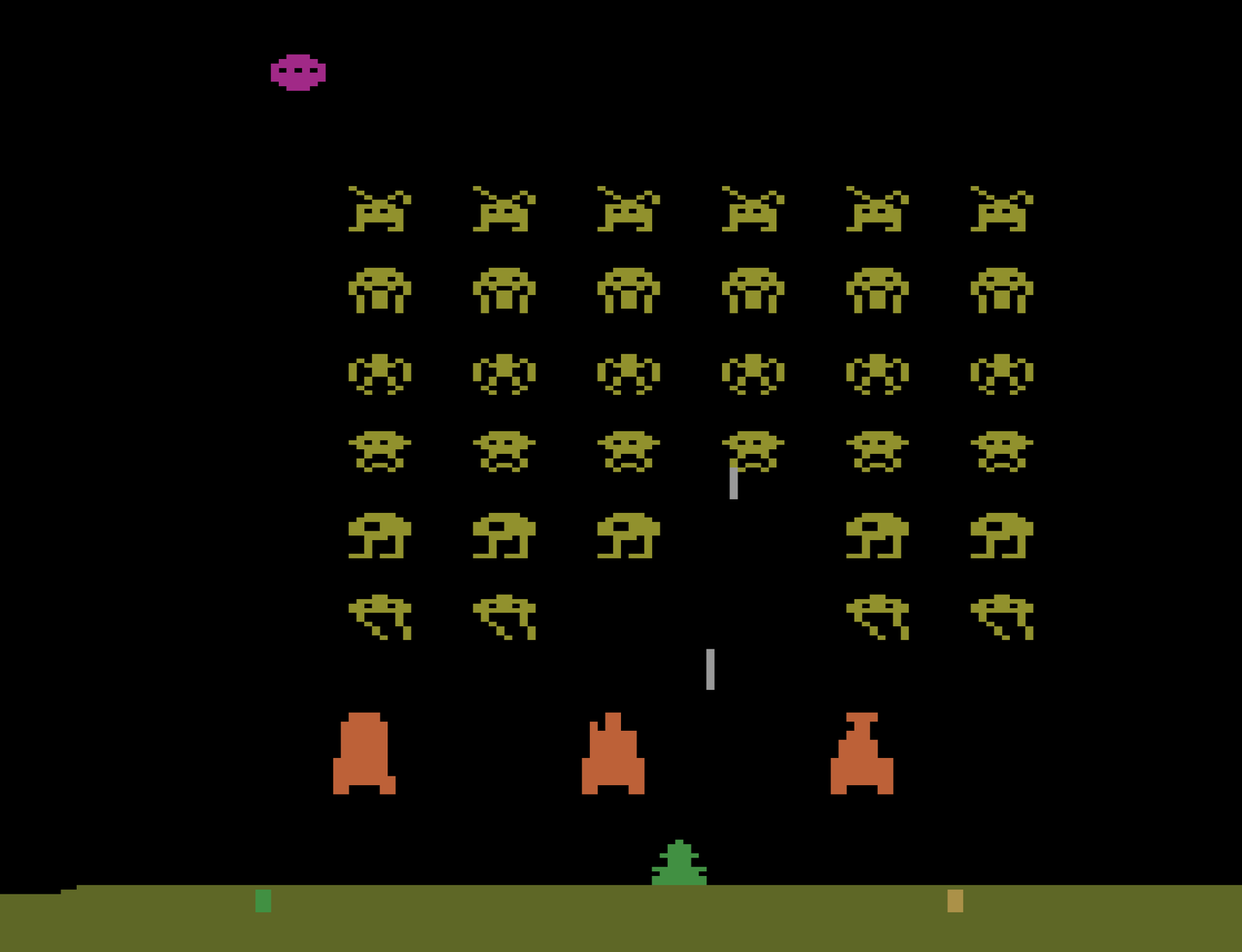

Reinforcement learning
Goal: play a 2D game with no initial knowledge of the rules
game state, st
Agent observes system state.
Agent takes action using its policy (moves the player).
Agent observes change in reward i.e. score.
Agents policy is gradually improved by rewarding successful actions, and penalising unsuccessful ones.
RL agent
actions (control player), at
reward (score), rt
Computer game

Slide 30
Challenges with machine learning
Data challenges
Quantity: not enough training data to generalise across new samples
Quality: garbage in, garbage out
Bias: non-representative or biased data can lead to poor predictions
Algorithm challenges
Overfitting: training a model that predicts well on training data, but not on new samples
Underfitting: using a model too simple to make good predictions
Picking an algorithm: no free lunch theorem

Slide 31

Thank you!
Post-workshop Anonymous Feedback Form 2024-25​
https://tinyurl.com/2d8fys7e​

